Slide 1

Avocado Production and Price Analysis
IST 718
Jazmin Maria Logroño
Katherine Hurtado-Da Silva
Xiangzhen He

Slide 2
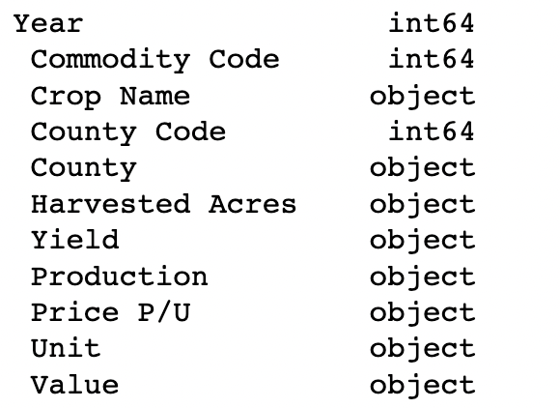
Background
About the Data
Avocado per capita consumption in the U.S. has grown drastically since 2000.
Most avocados produced in the US are from California.
California is a State well-known for its droughts and, in the recent years, wildfires.
Important for companies to understand avocado production and prices to keep up with demand and optimize pricing.
Kaggle is hosting the California Avocado Production dataset
420 rows with yearly values for 27 California counties for year 1980-2020
Data cleaning: ​
Removed extra spaces in the column names and cells​
Dropped records with missing values​
Updated data types

Slide 3
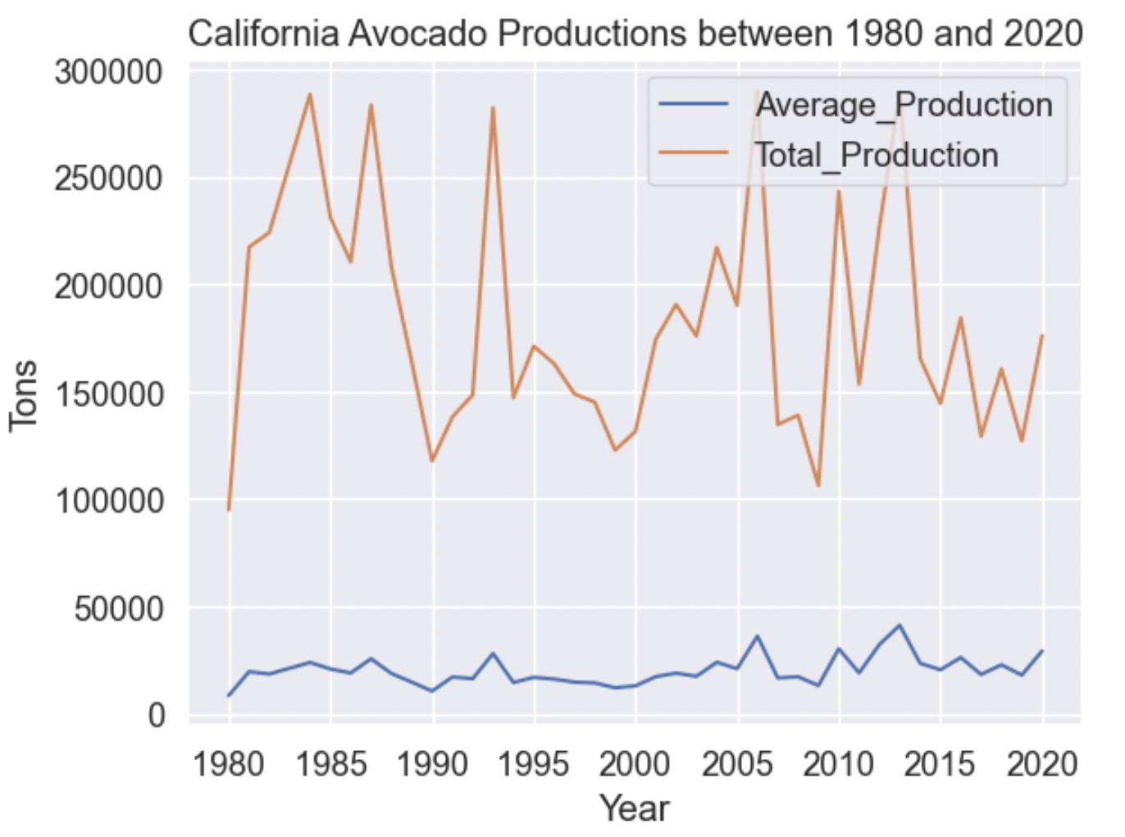
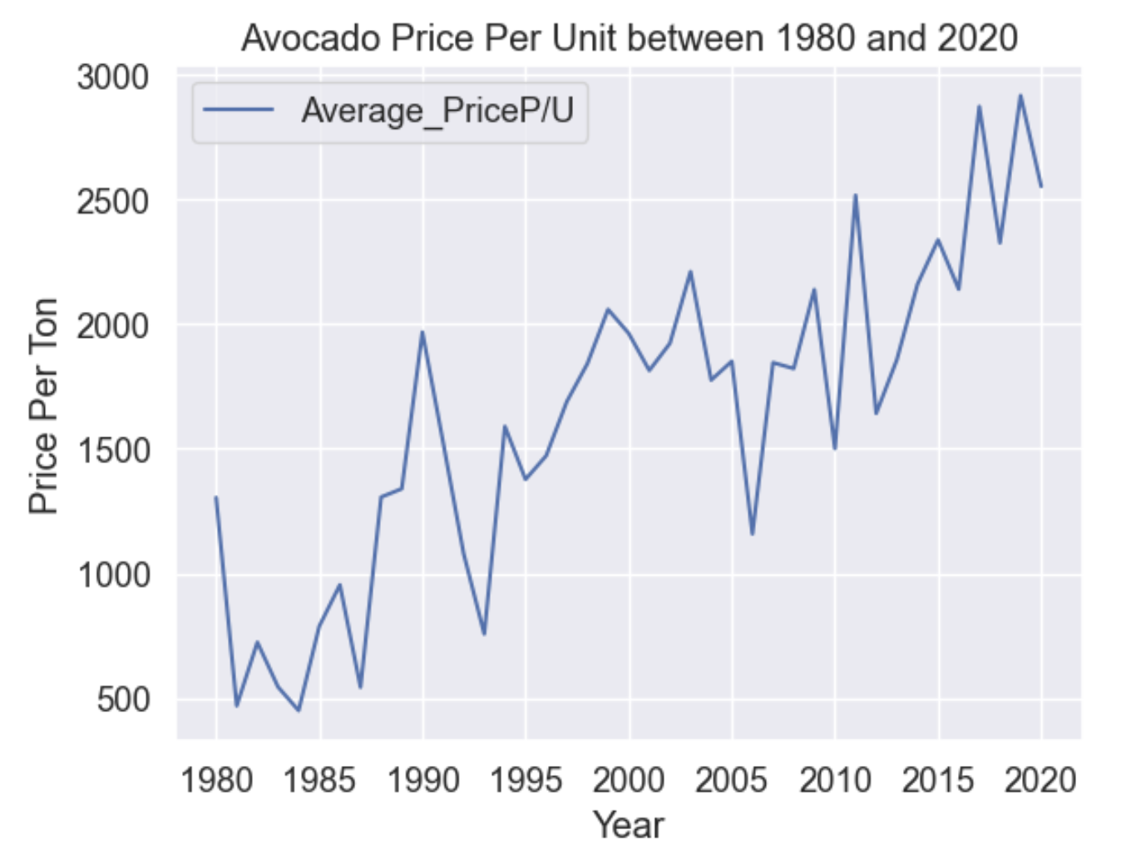
Data Exploration: Production vs Unit Price
The graphs show there is a cyclical pattern in Avocado Production and Unit Price
The intervals between each cycle have been getting shorter and shorter

Slide 4
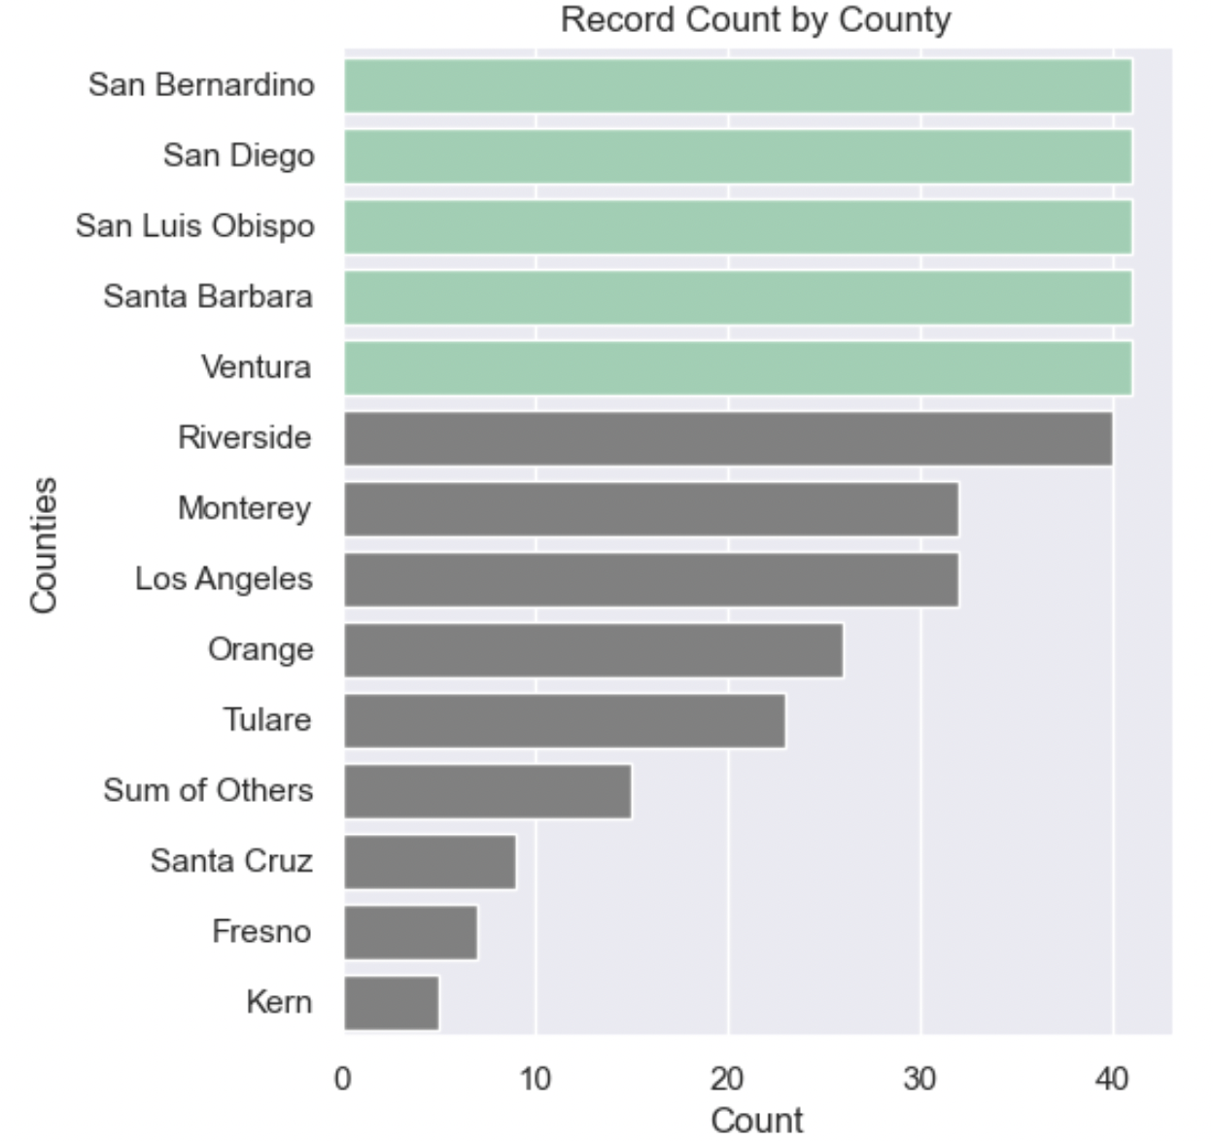
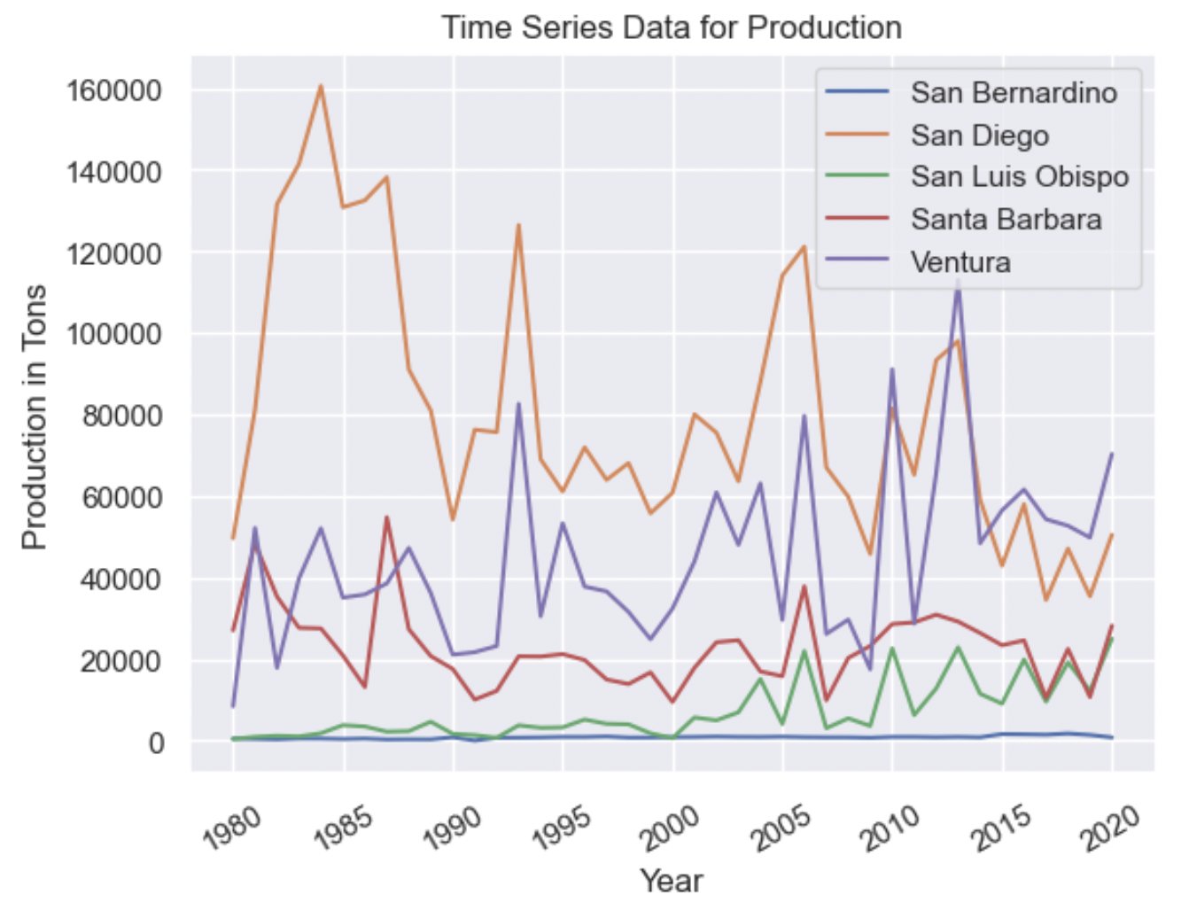
Data Exploration at County Level
San Bernardino, San Diego, San Luis Obispo, Santa Barbara and Ventura County are the only five counties that have 41 years of records between 1980 and 2020.
Productions are higher in San Diego and Ventura County

Slide 5
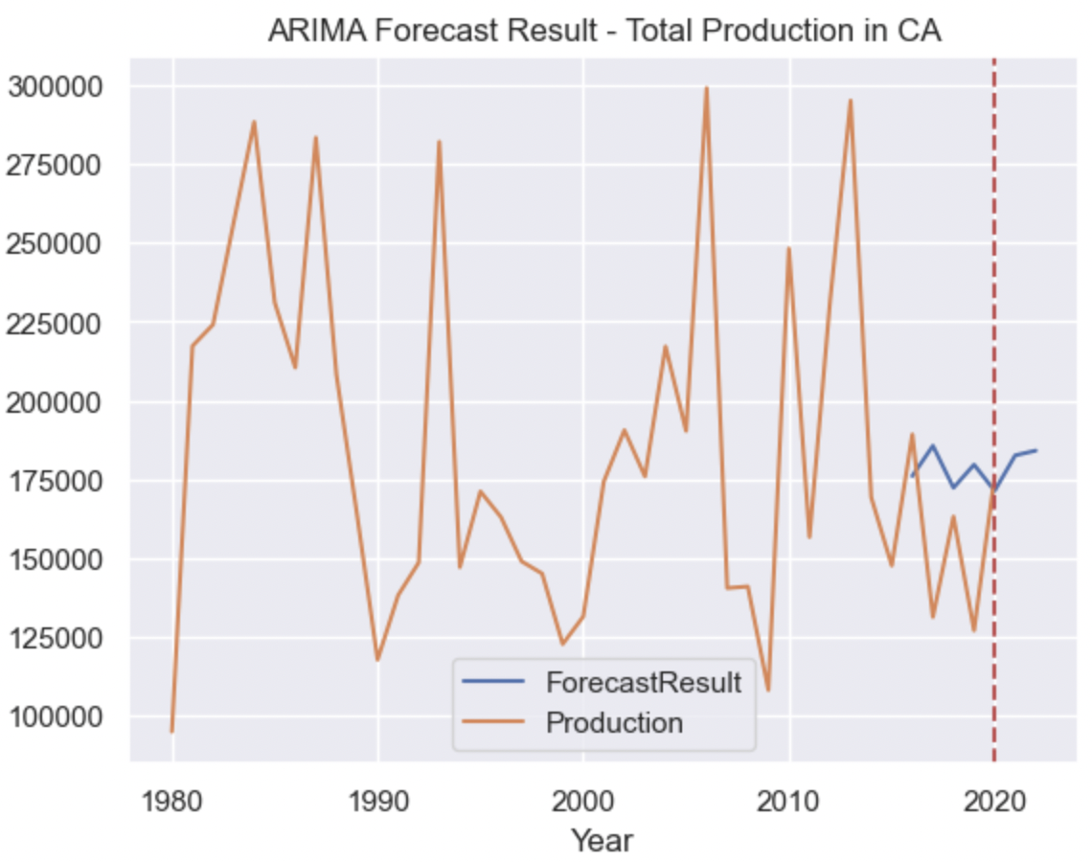
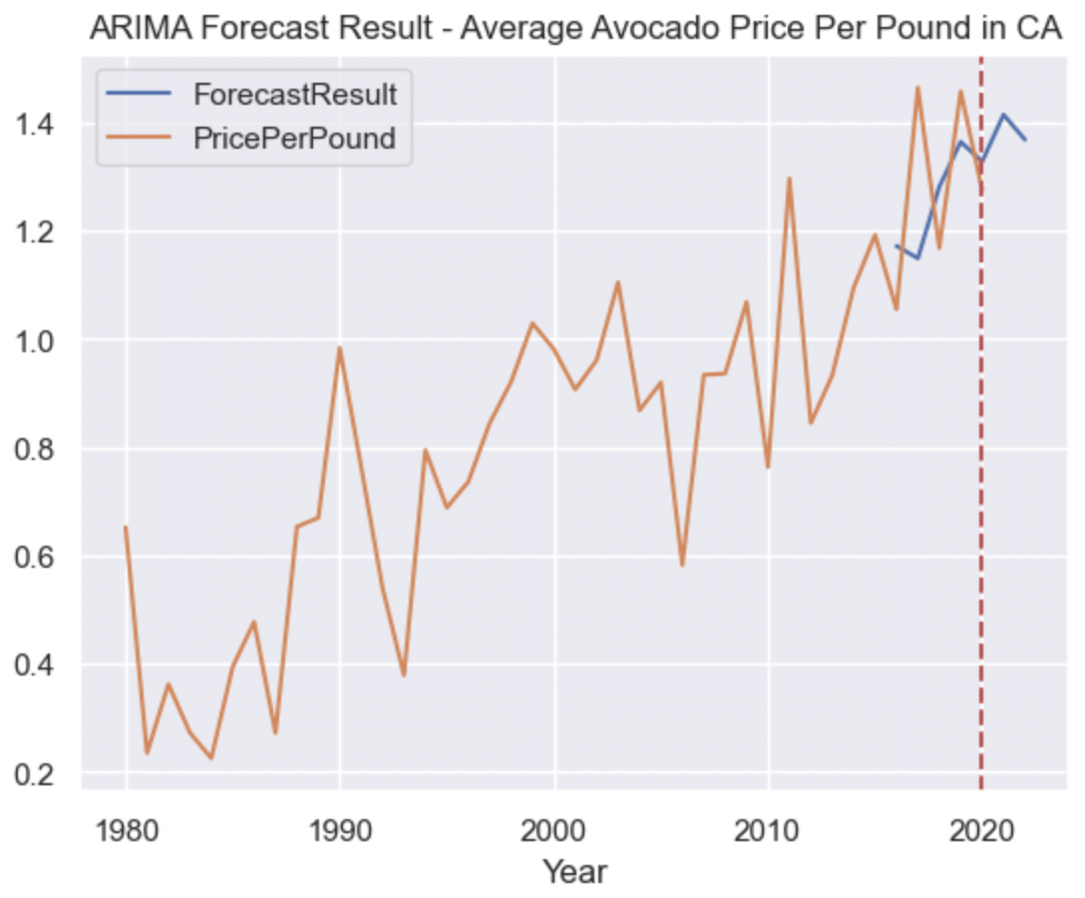
ARIMA – Predict Total Production and Average Unit Price
Forecasted Production Values:
2021: 182,588 Tons
2022: 184,092 Tons
Forecasted Unit Price Values:
2021: $1.41 per pound
2022: $1.37 per pound
Notes:
90% data used for training, 10% used for model evaluation, and final model used to make predictions for 2021 and 2022 results

Slide 6
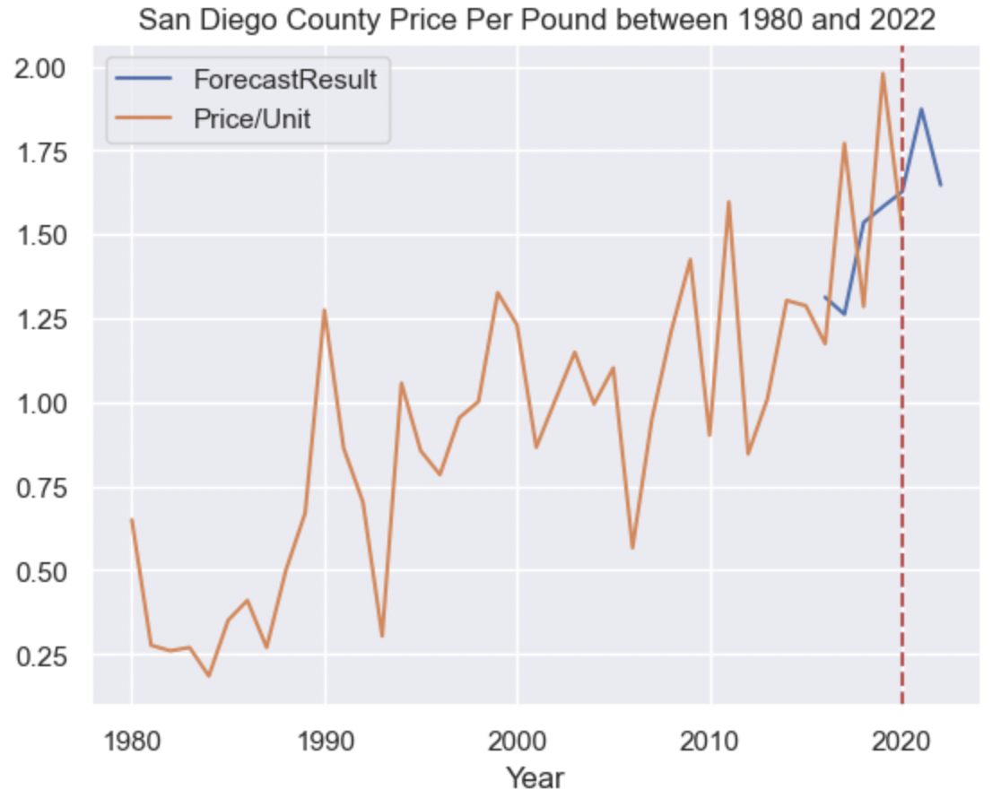
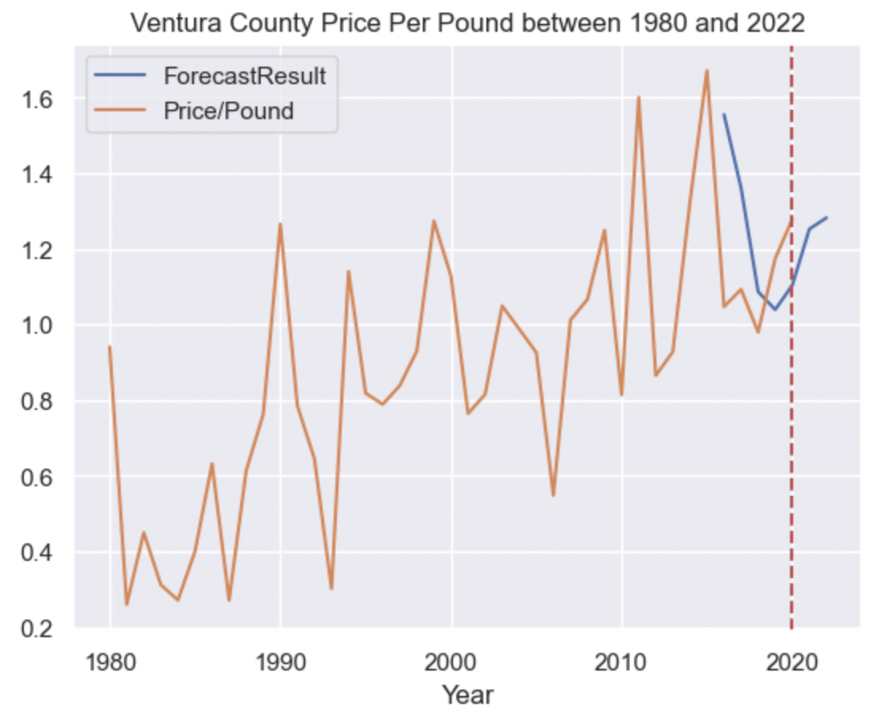
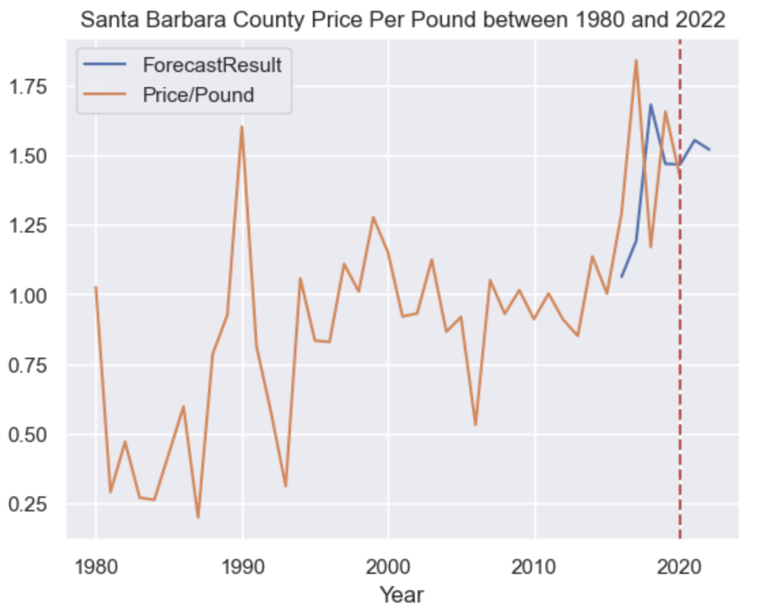
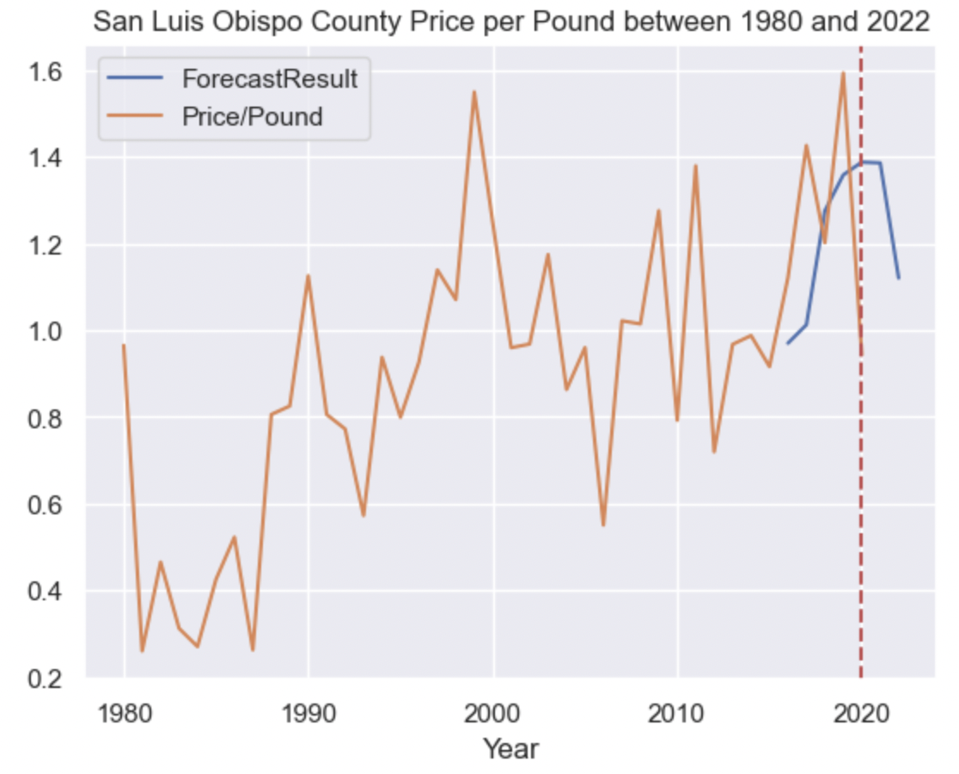
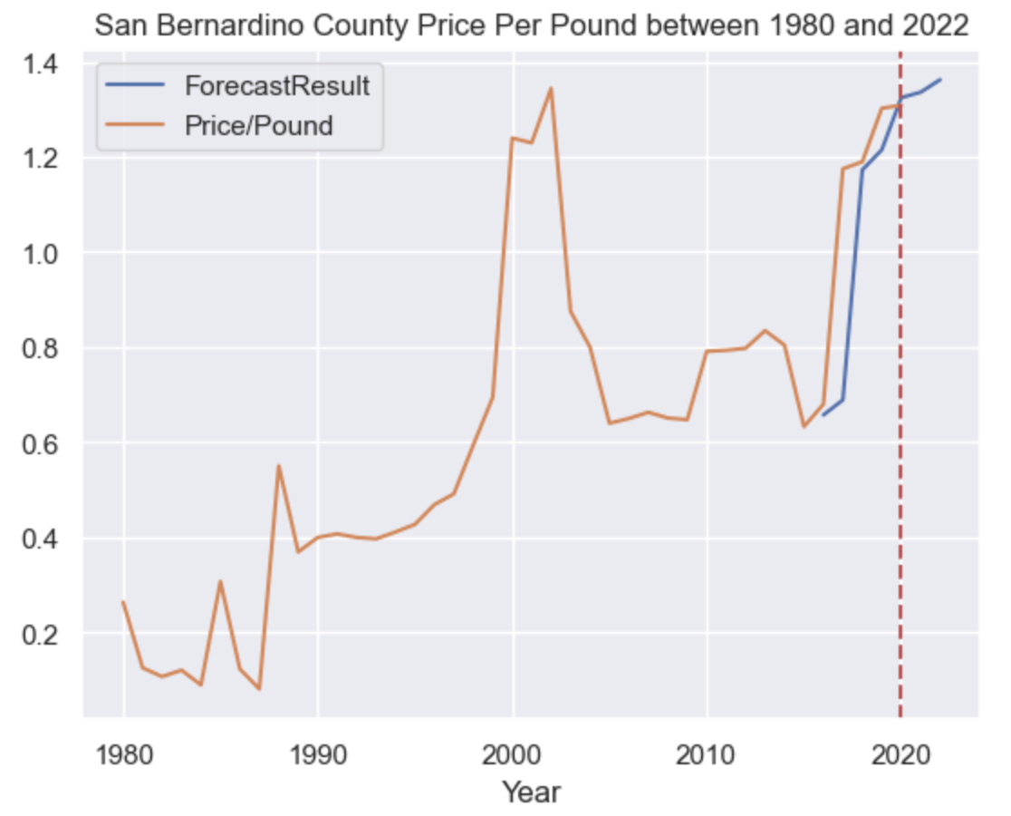
Predict 2021-2022 Avocado Production and Unit Price by County
Forecast increases in production in San Diego, Ventura and Santa Barbara Counties in 2021 and 2022. Average RMSE on evaluation/test data is 8,062.
Forecast increases in unit price in San Diego, Ventura and San Bernardino Counties. Average RMSE on evaluation/test data is 0.30

Slide 7
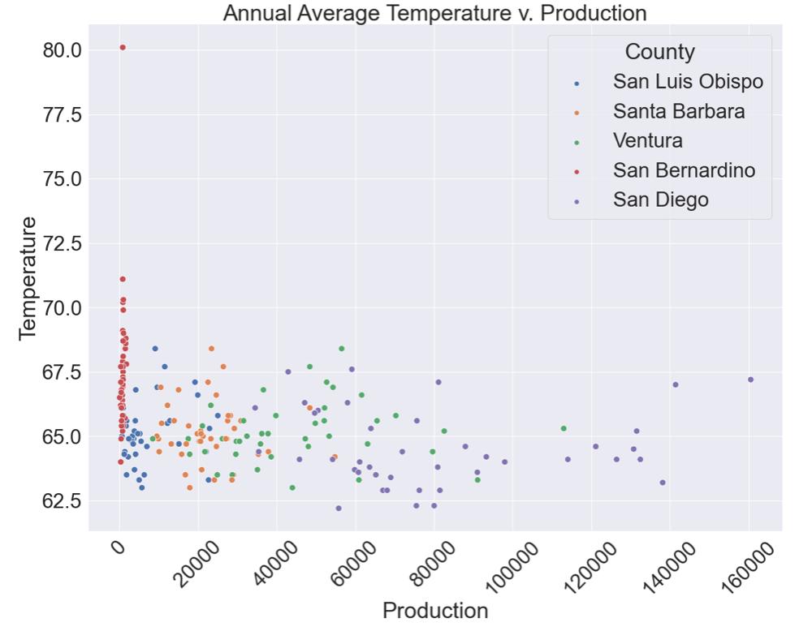
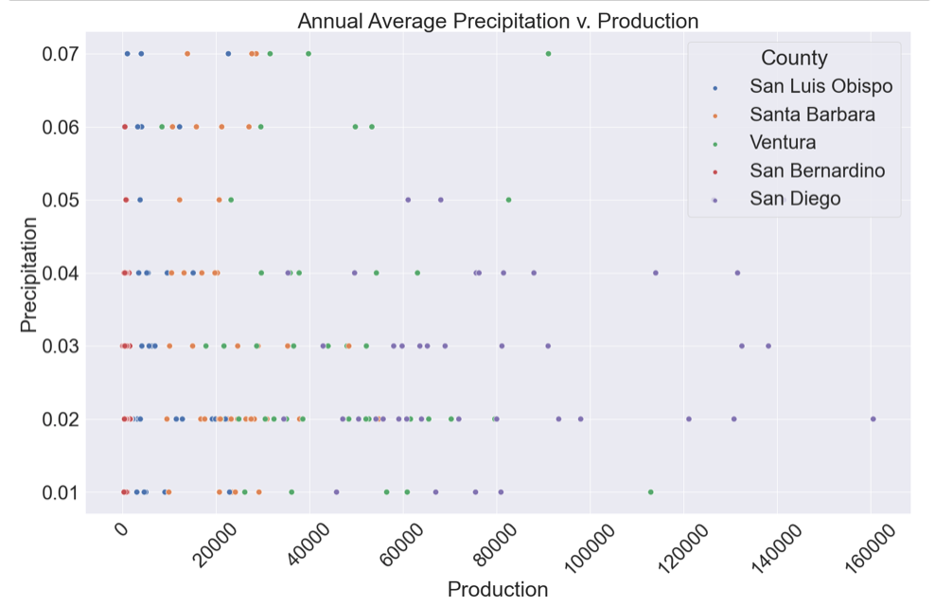
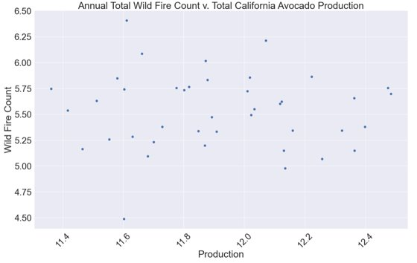
Correlation of Environmental Regressors with Avocado Production
Annual average temperatures and precipitation levels were found for each county.
Average temperature appeared to have a positive and very weak association with avocado production in San Diego, Ventura, San Luis Obispo, and San Bernardino. Santa Barbara's production had a negative and very weak association with its average temperature levels.
Average precipitation appeared to have a negative and very weak association with avocado production in all counties except San Diego, which had a positive and very weak association.

Slide 8
Prophet- Impact of Environmental Regressors on County Avocado Production
County | Production RMSE on Test Set | Production & Temperature RMSE on Test Set | Production & Precipitation RMSE on Test Set | Production & Wildfire RMSE on Test Set
California | 133,250.98 | N/A | N/A | 4.770151969834234e+47
Ventura | 4,355.55 | 2.2189758173940270406 e+1305 | 281.70 | N/A
San Bernardino | 436.46 | 1.7409024065682025788 e+699 | 10,828.81 | N/A
Santa Barbara | 12,025.95 | 21,130.35 | 4,503.36 | N/A
San Luis Obispo | 12,930.17 | 16,893.49 | 1,409.10 | N/A
San Diego | 51,319.93 | 2.7546451867950760886e+1783 | 9,706.88 | N/A
Annual mean precipitation levels improved the production forecasting performance for all counties except San Bernardino.
At the state level, California production forecast did not improve with wildfire count as a regressor.
Compared to ARIMA, the best prophet model for each county had lower RMSE values, indicating precipitation as a regressor for county-wide avocado production was effective in improving forecasting performance.

Slide 9
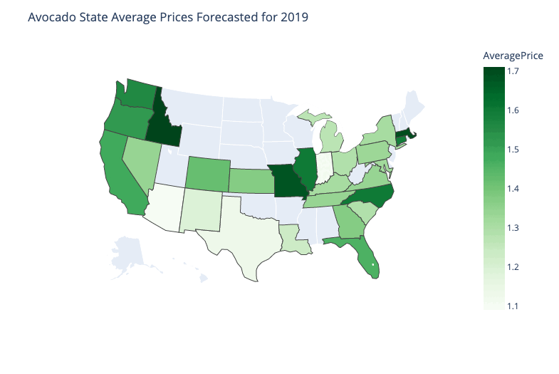
Predicting Average Avocado Prices for United States using Prophet Model

Slide 10
References
https://www.statista.com/statistics/257192/per-capita-consumption-of-fresh-avocados-in-the-us/
https://www.kaggle.com/datasets/jarredpriester/california-avocado-production-19802020
https://www.kaggle.com/datasets/neuromusic/avocado-prices
https://www.weather.gov/wrh/Climate?wfo=mtr
https://hub-calfire-forestry.hub.arcgis.com/search?categories=cal%20fire%20public%20data&tags=Fire%20and%20Fuels

